Slide 1
Applied Machine Learning SEZG568/SSZG568
Dr Y V K RAVI KUMAR
yvk.ravikumar@pilani.bits-pilani.ac.in

Slide 2
Session 10(14th October,2023)

Slide 3
Session 10 – 14th October,2023
10 | Classification Models II: Ensembles techniques. Bagging, boosting, Random Forest | T1: Chapter 7 T2: Chapter 5

Slide 4
Session Content
Module-6
Classification Models II
Challenges with Decision tree
Ensembles
1. Bagging
2. Boosting
4. Random Forest

Slide 5
Prefer shorter hypotheses: Occam's razor
Why?
Occam's razor says that when presented with competing hypotheses that make the same predictions, one should select the solution which is simple“
Arguments in favor
There are fewer short hypotheses than long ones
If a short hypothesis fits data unlikely to be a coincidence
Elegance and aesthetics
Arguments against
Not every short hypothesis is a reasonable one.

Slide 6
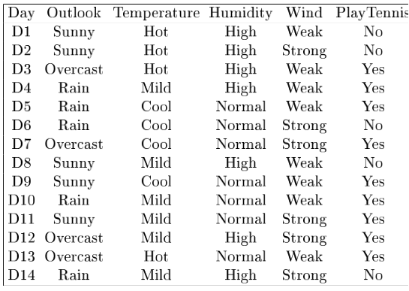
Example
D15 Sunny Hot Normal Strong No
Notes:
L’ esempio D15 è sbagliato, introduce rumore nei dati.

Slide 7
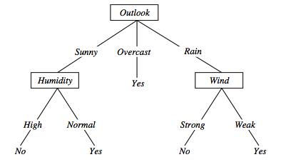
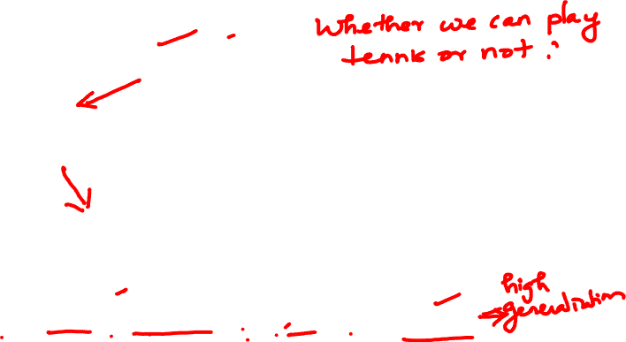
Overfitting in decision trees
〈Outlook=Sunny, Temp=Hot, Humidity=Normal, Wind=Strong, PlayTennis=No 〉
This new example causes splitting of second leaf node.
Notes:
The example shows that noise can lead to overfitting.
Overfitting without noise is also possible, especially when classifcation decision on the leafs are based on few examples. Uniform classification may be a coincidence.
This is a potential cause of overfitting.
Overfitting is a significant problem for DT, reducing the accuracy to 10-25% on many problems.

Slide 8
Avoid overfitting in Decision Trees
Two strategies:
Stop growing the tree earlier, before perfect classification
Leaf nodes are impure
Allow the tree to overfit the data, and then post-prune the tree
Training and validation set
split the training in two parts (training and validation) and use validation to assess the utility of post-pruning
Reduced error pruning
Rule post pruning
Notes:
Usando tutti dati di training, un test statistico può predire l’ influenza delle decisioni se espandere (o potare) sulle prestazioni su tutto X.
Minimum description length principle, un principio di compattezza della rappresentazione.

Slide 9
Reduced-error pruning
Each node is a candidate for pruning
Pruning consists in removing a subtree rooted in a node
the node becomes a leaf and is assigned the most common classification
Nodes are removed only if the resulting tree performs no worse on the validation set.
Nodes are pruned iteratively
at each iteration the node whose removal increases accuracy the most on the validation set is pruned.
Pruning stops when no pruning increases accuracy
Notes:
Potatura sulla base di errori ridotti, valutati sul validation set.

Slide 10
Reduced-error pruning
Partition training data in “train” and “validation” sets.
Build a complete tree from the “train” data
While pruning doesn’t harm:
For each non leaf node, n in the tree do:
Temporarily prune the subtree below n and replace it with a leaf labelled with the current majority class at that node.
Measure and record the accuracy of the pruned tree on the validation set
4.Permantenly prune the node that in the greatest increase in the accuracy on the validation set.
Notes:
Potatura sulla base di errori ridotti, valutati sul validation set.

Slide 11
Reduced-error pruning
Notes:
Potatura sulla base di errori ridotti, valutati sul validation set.

Slide 12
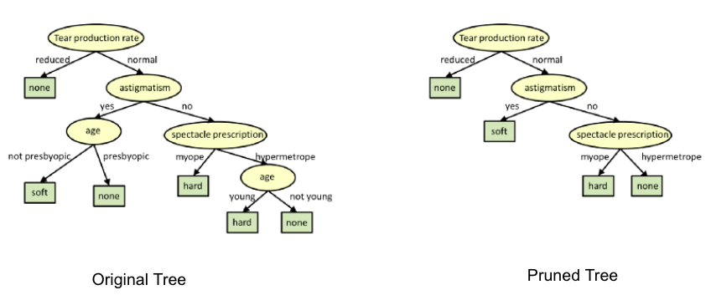
Reduced-error pruning
Notes:
Potatura sulla base di errori ridotti, valutati sul validation set.

Slide 13
Reduced-error pruning
Drawbacks:
What happens if we have a small dataset?, so that we cannot have enough training set
and validation set
Is there a solution?
Rule post pruning approach
Notes:
Potatura sulla base di errori ridotti, valutati sul validation set.

Slide 14
Rule post-pruning
Create the decision tree from the training set
Convert the tree into an equivalent set of rules
Each path corresponds to a rule
Each node along a path corresponds to a pre-condition
Each leaf classification to the post-condition
Prune (generalize) each rule by removing those preconditions whose removal improves accuracy
over validation set
Sort the rules in estimated order of accuracy, and consider them in sequence when classifying new instances

Slide 15
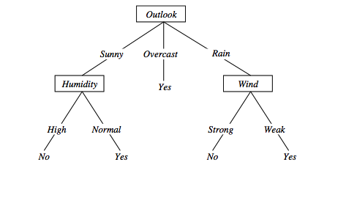
Converting to rules
5 paths, hence 5 rules
Each node gives precondition
Classification is the post condition
(Outlook=Sunny)∧(Humidity=High) ⇒ (PlayTennis=No)

Slide 16
Rule Post-Pruning
Convert tree to rules (one for each path from root to a leaf)
For each antecedent in a rule, remove it if error rate on validation set does not decrease
Sort final rule set by accuracy
Outlook=sunny ^ humidity=high -> No
Outlook=sunny ^ humidity=normal -> Yes
Outlook=overcast -> Yes
Outlook=rain ^ wind=strong -> No
Outlook=rain ^ wind=weak -> Yes
Compare first rule to:
Outlook=sunny->No
Humidity=high->No
Calculate accuracy of 3 rules based on validation set and pick best version.

Slide 17
Why converting to rules?
Each distinct path produces a different rule
a condition removal may be based on a local (contextual) criterion.
Node pruning is global and affects all the rules
Provides flexibility of not removing entire node
In rule form, tests are not ordered and there is no book-keeping involved when conditions (nodes) are removed
Converting to rules improves readability for humans

Slide 18
Problems with information gain
Natural bias of information gain: it favors attributes with many possible values.
Consider the attribute Date in the PlayTennis example.
Date would have the highest information gain since it perfectly separates the training data.
It would be selected at the root resulting in a very broad tree
Very good on the training, this tree would perform poorly in predicting unknown instances.
Leading to overfitting.
The problem is that the partition is too specific, too many small classes are generated.
We need to look at alternative measures …

Slide 19
An alternative measure: Gain Ratio
c |S_{i} | |S_{i} |
SplitInformation(S, A) ≡ − Σ log₂ i=1 |S | |S |
S_{i} are the sets obtained by partitioning on value i of A
SplitInformation measures the entropy of S with respect to the values of A.
The more uniformly dispersed the data the higher it is.
Gain(S, A)
GainRatio(S, A) ≡
SplitInformation(S, A)
GainRatio penalizes attributes that split examples in many small classes such as Date.
Let |S |=n, Date splits examples in n classes
SplitInformation(S, Date)= −[(1/n log₂ 1/n)+…+ (1/n log₂ 1/n)]= −log₂1/n =log₂n
Compare with A, which splits data in two even classes:
SplitInformation(S, A)= − [(1/2 log₂1/2)+ (1/2 log₂1/2) ]= − [− 1/2 −1/2]=1
Notes:
2^{-x} = 1/2^{x}

Slide 20
Dealing with continuous-valued attributes
Given a continuous-valued attribute A, dynamically create a new attribute A_{c}
A_{c} = True if A < c, False otherwise
How to determine threshold value c ?
Example. Temperature in the PlayTennis example
Sort the examples according to Temperature
Temperature 40 48 | 60 72 80 | 90
PlayTennis No No 54 Yes Yes Yes 85 No
Determine candidate thresholds by averaging consecutive values where there is a change in classification: (48+60)/2=54 and (80+90)/2=85

Slide 21
Applications
Suited for following classification problems:
Applications whose Instances are represented by attribute-value pairs.
The target function has discrete output values
Disjunctive descriptions may be required
The training data may contain missing attribute values
Real world applications
Biomedical applications
Manufacturing
Banking sector
Make-Buy decisions

Slide 22
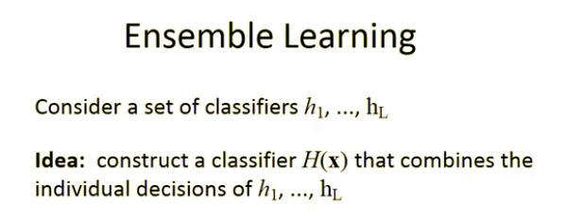
Ensemble of Classifiers
Why and when ensembles work?
Bagging technique

Slide 23
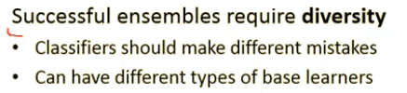

Slide 24
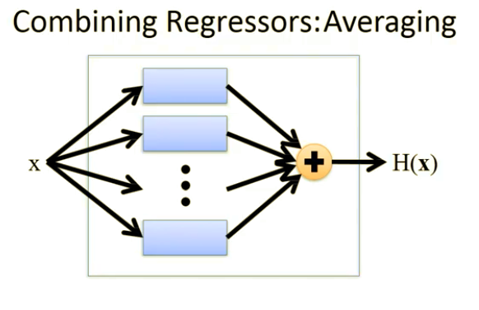
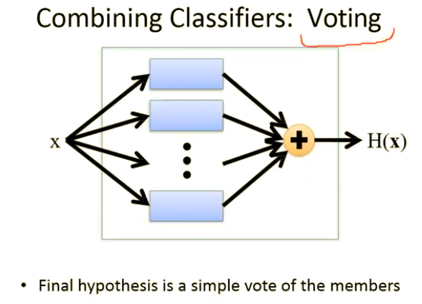
Ensemble- Classifiers and Regressors

Slide 25
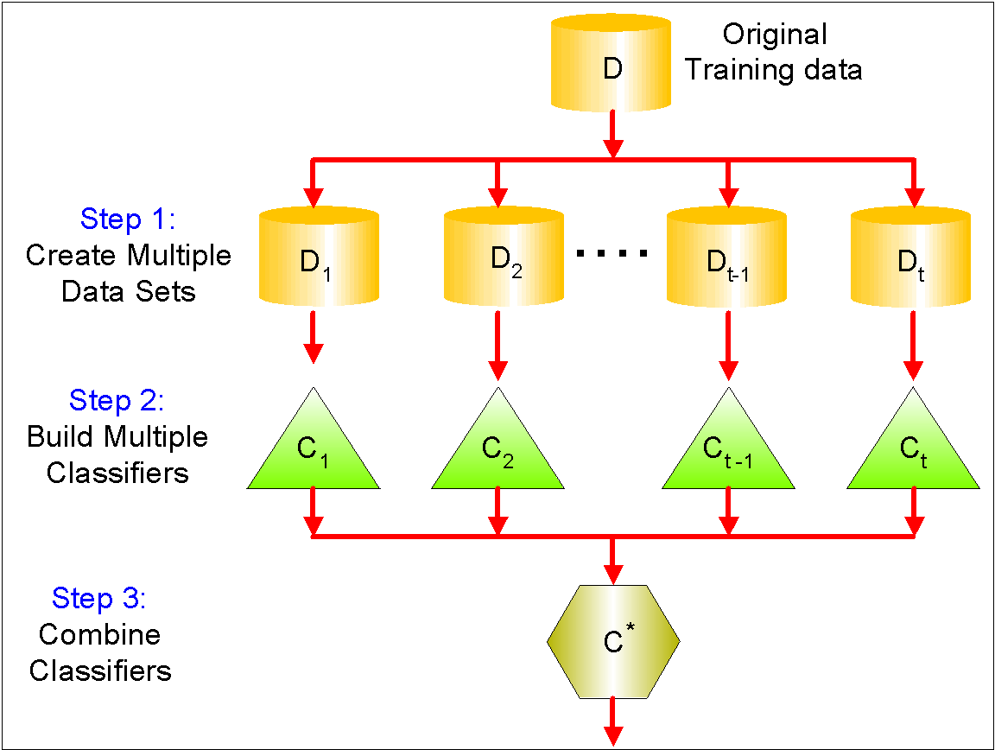
Ensemble Methods
Ensemble techniques: Improve classification accuracy by aggregating the predictions of multiple classifiers
General Procedure:
Construct set of base classifiers from training data
.Predict class label of previously unseen records by aggregating predictions made by each base classifier

Slide 26
Why Ensemble Methods work?
Error rate
How can an ensemble method improve a classifier’s performance?
¨Assume we have 25 binary classifiers
¨Each has error rate: ε= 0.35
If all 25 classifiers are identical:
. They will vote the same way on each test instance
. Ensemble error rate: ε= 0.35

Slide 27
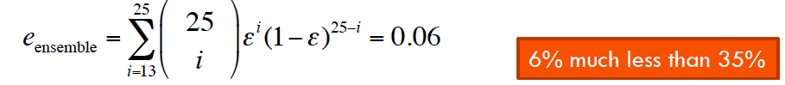
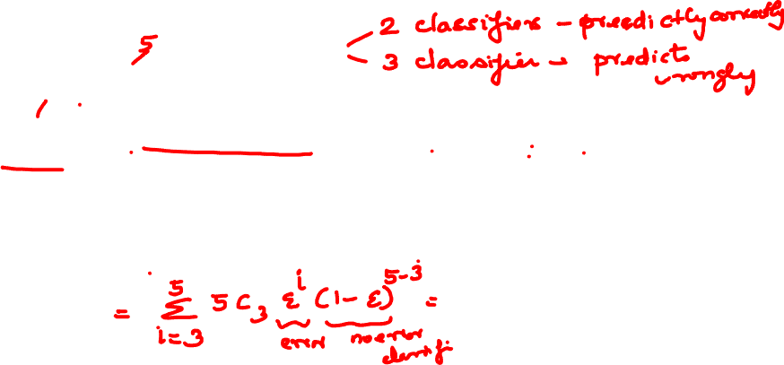
Why Ensemble Methods work?
Error rate
Assume we have 25 binary classifiers
Each has error rate: ε= 0.35
If all 25 classifiers are independent (errors are uncorrelated)
Ensemble method only makes a wrong prediction if more than half of the base classifiers predict incorrectly.

Slide 28
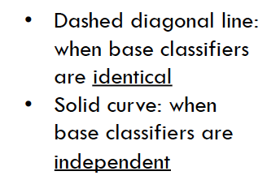
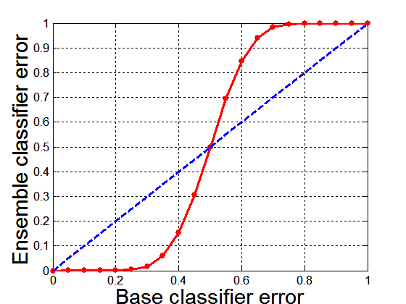
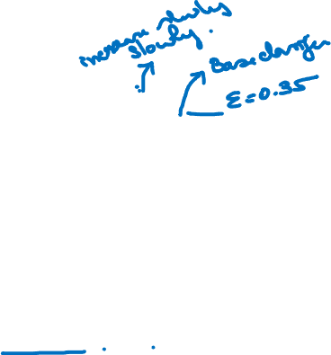
Why Ensemble Methods work?
25 base classifiers
Comparison of 25 base classifiers when error rate is varied

Slide 29
When does Ensemble work?
Ensemble classifier performs better than the base classifiers when error is smaller than 0.5
Necessary conditions for an ensemble classifier to perform better than a single classifier
Base classifiers should be independent of each other
Base classifiers should do better than a classifier that performs random guessing
Ensemble Methods work best with unstable base classifiers
Classifiers that are sensitive to minor perturbations in training set, due to high model complexity
Examples: Unpruned decision trees, ANNs, …
Low Bias in finding optimal decision boundary
High Variance for minor changes in training set or model selection procedure

Slide 30
Examples
Simple Ensemble Techniques
Example: Movie rating
Max Voting
The result of max voting would be
Rating by 5 friends: 5 4 5 4 4
Averaging
(5+4+5+4+4)/5 = 4.4 Final rating
Weighted Average
Weight-0.23 0.23 0.18 0.18 0.18
The result is calculated as [(5*0.23) + (4*0.23) + (5*0.18) + (4*0.18) + (4*0.18)] = 4.41.

Slide 31
Methods for Constructing an Ensemble Classifier
1. By manipulating the training set.
2. By manipulating the input features.
3. By manipulating the class labels.
4. By manipulating the learning algorithm.

Slide 32
1. By manipulating the training set.
Multiple training sets created by resampling original data
Resample according to some sampling distribution
. Example: equal probability
. Example: weighted
. Determines how likely it is that an example will be selected for training.
Classifier built from each training set.
Ensemble methods that manipulate the training set:
Bagging
Boosting

Slide 33
2. By manipulating the input features.
Subset of input features is chosen at random from overall collection of features
Each training set has different feature set
Ensemble method that manipulates input features:
Random Forest
Works well with datasets that contain highly redundant features

Slide 34
3. By manipulating the class labels
Used when there is a large number of classes
Transform into many binary class problems
Training Approach:
Randomly partition class labels into two disjoint subsets A0 (class 0) and A1(class 1)
Train a base classifier based on this class reassignment.
Repeat multiple times, once for each base classifier.
Testing Approach:
Each base classifier predicts test instance with its respective binary class subset
All classes in subset receive a vote
Class with highest count wins

Slide 35
4. By manipulating the learning algorithm
… so that applying algorithm on same training data may result in different models
How to introduce randomness into decision tree induction?
Instead of choose best splitting attribute at each node, randomly choose one of top k attributes for splitting

Slide 36
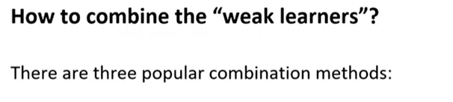
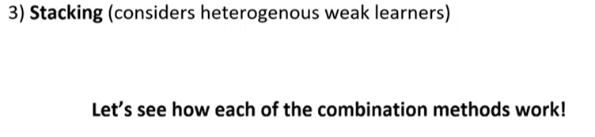

Slide 37
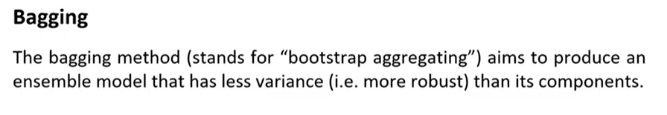
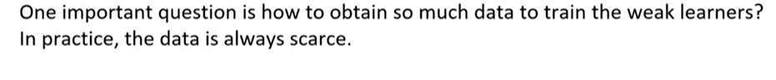
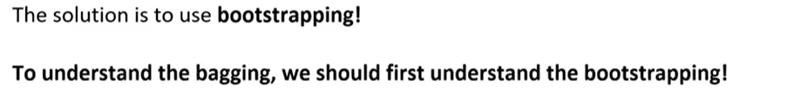

Slide 38
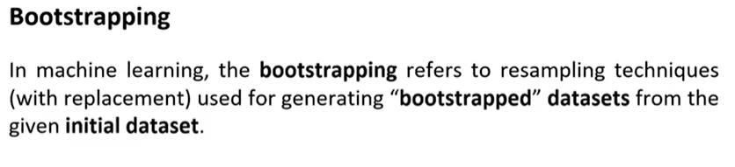

Slide 39
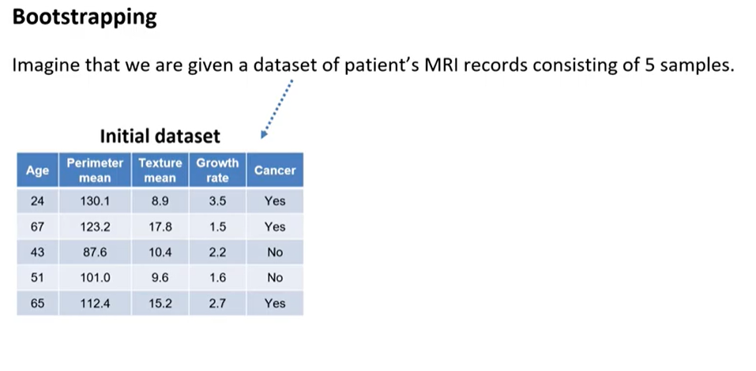

Slide 40
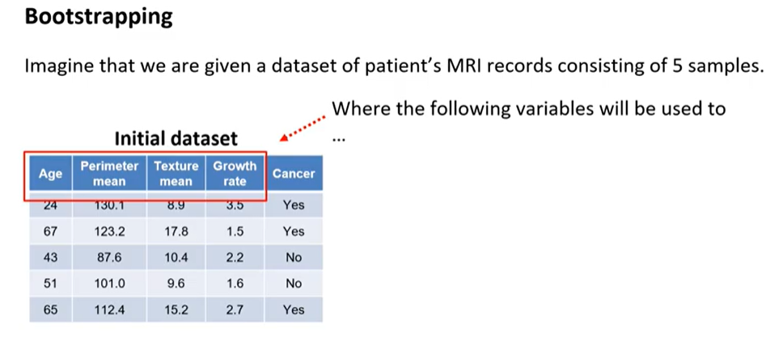

Slide 41
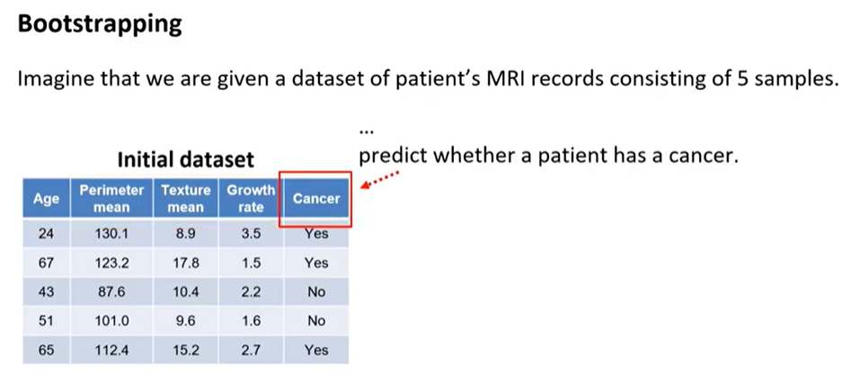

Slide 42
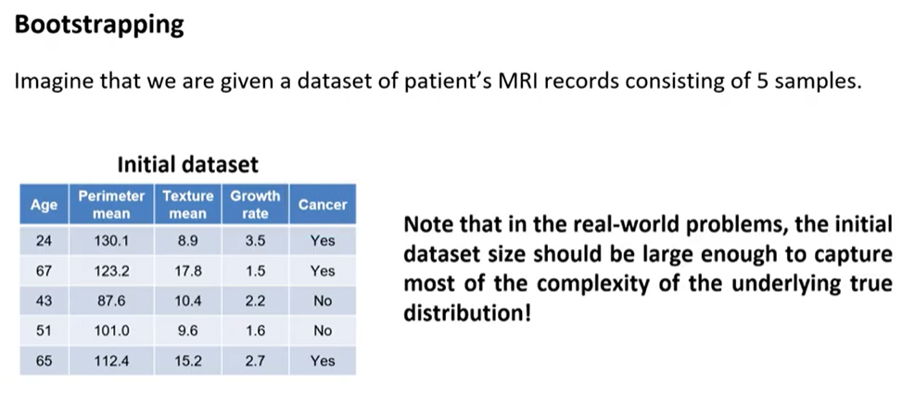

Slide 43
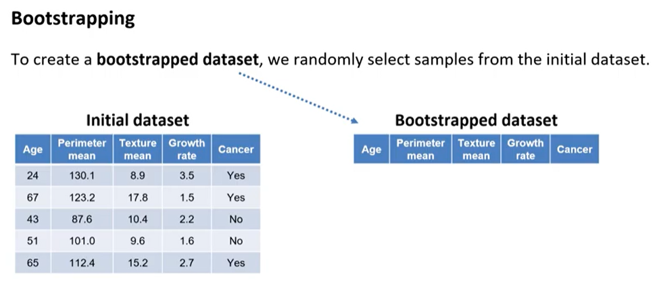

Slide 44
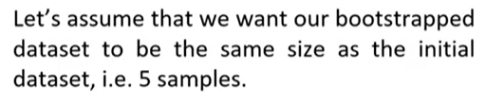

Slide 45
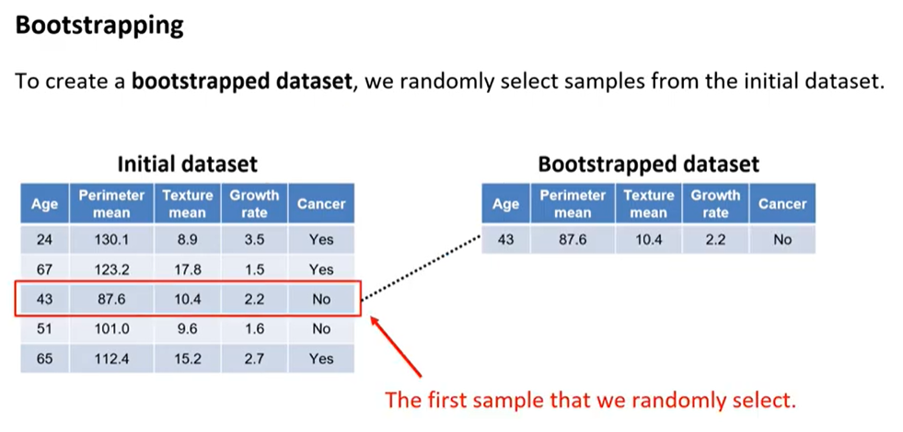

Slide 46
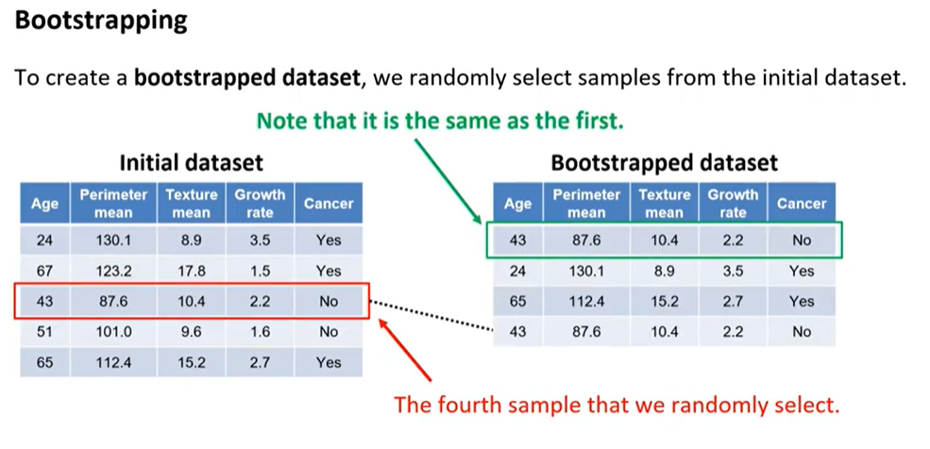

Slide 47
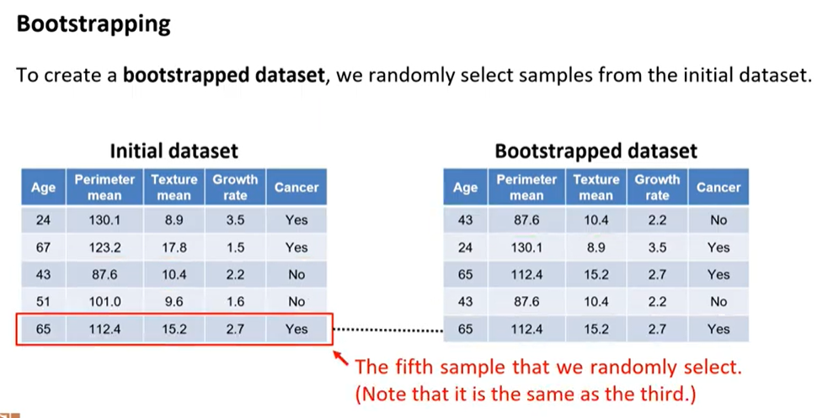

Slide 48
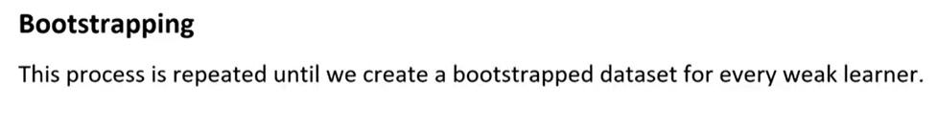
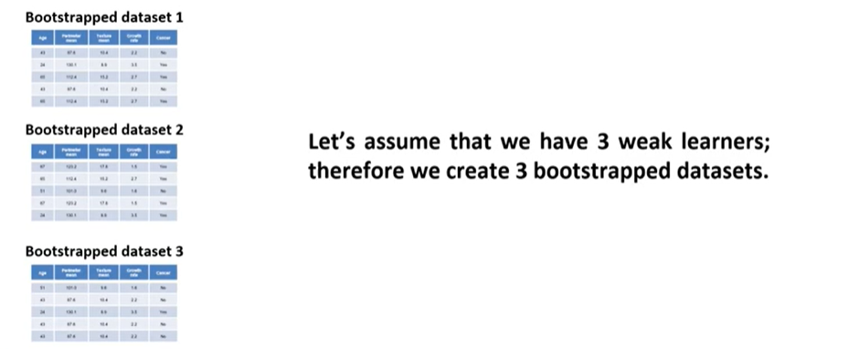

Slide 49
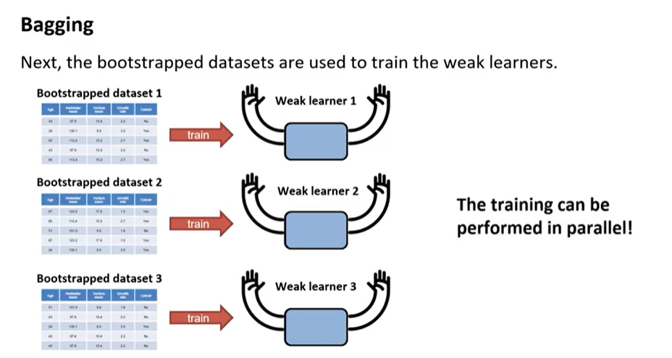

Slide 50
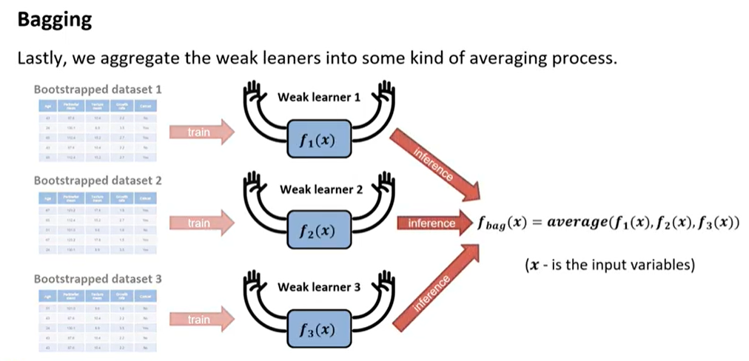

Slide 51
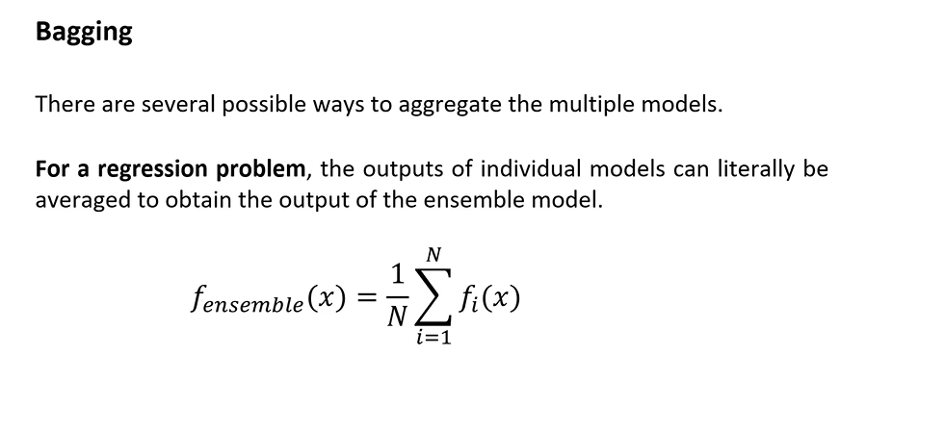

Slide 52
Bagging - Bootstrap AGGregatING
Technique uses these subsets (bags) to get a fair idea of the distribution (complete set).
The size of subsets created for bagging may be less than the original set.
Bootstrapping is a sampling technique in which we create subsets of observations from the original dataset, with replacement.
When you sample with replacement, items are independent.
One item does not affect the outcome of the other.
You have 1/7 chance of choosing the first item and a 1/7 chance of choosing the second item.

Slide 53
Bagging Bootstrap AGGregatING
If the two items are dependent, or linked to each other.
When you choose the first item, you have a 1/7 probability of picking a item.
Assuming you don’t replace the item, you only have six items to pick from. That gives you a 1/6 chance of choosing a second item, and so on …

Slide 54
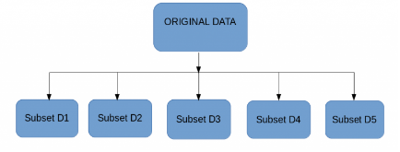
Bagging
Multiple subsets are created from the original dataset, selecting observations with replacement.
A base model (weak model) is created on each of these subsets.
The models run in parallel and are independent of each other.
The final predictions are determined by combining the predictions from all the models.

Slide 55
Bagging
1.Sampling with replacement
2. Build classifier on each bootstrap sample
3. Each sample has the probability (1 – 1/n)^{n} selected as test data
4. Training data = 1- (1 – 1/n)^{n} of the original data
Goal: find a collection of 10 simple thresholding classifiers that collectively can classify correctly. -Each simple (or weak) classifier is:
(x<=K -> class = +1 or -1 depending on which value yields the lowest error; where K is determined by entropy minimization)

Slide 56
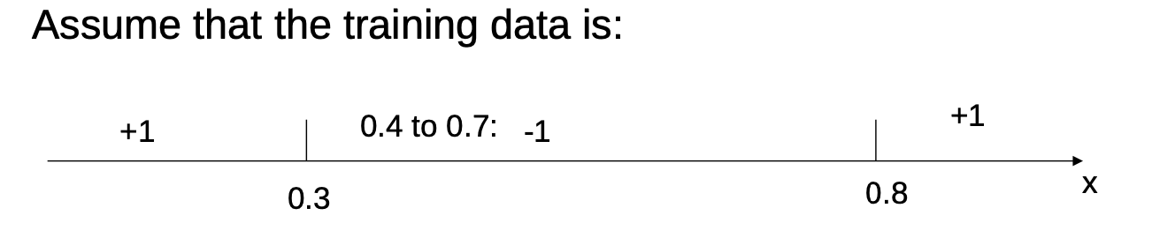
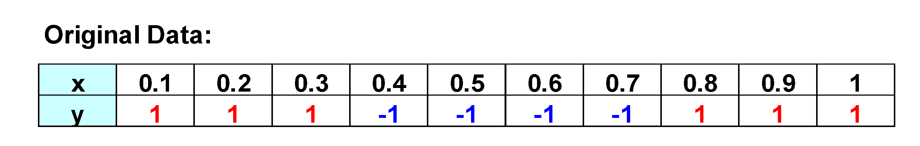
Bagging Example
Consider this one-dimensional dataset
Classifier is a decision stump
Decision rule: x ≤ k versus x > k
Split point k is chosen based on entropy
x ≤ k
True
False
y_{left}
y_{right}

Slide 57
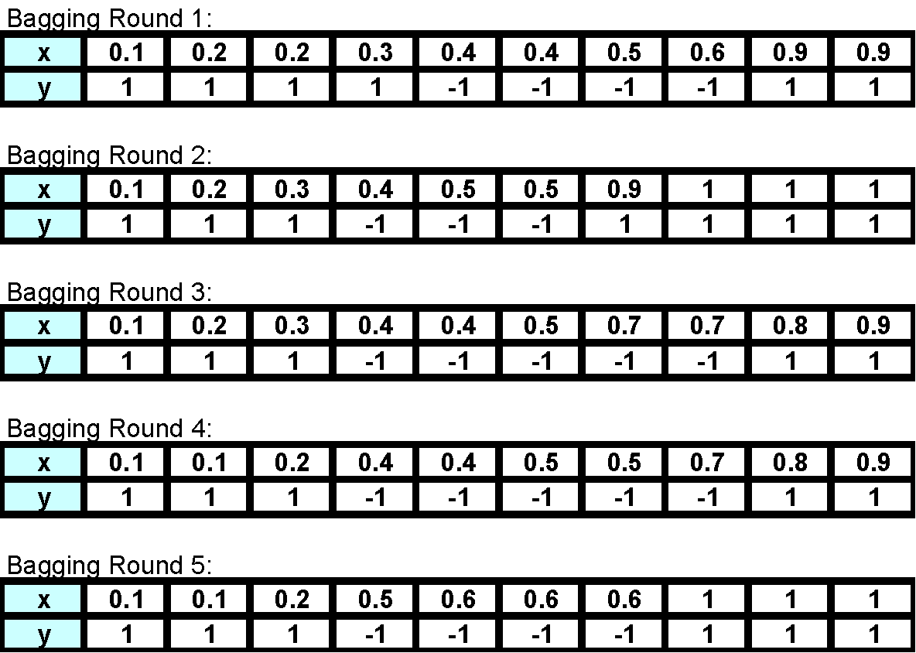
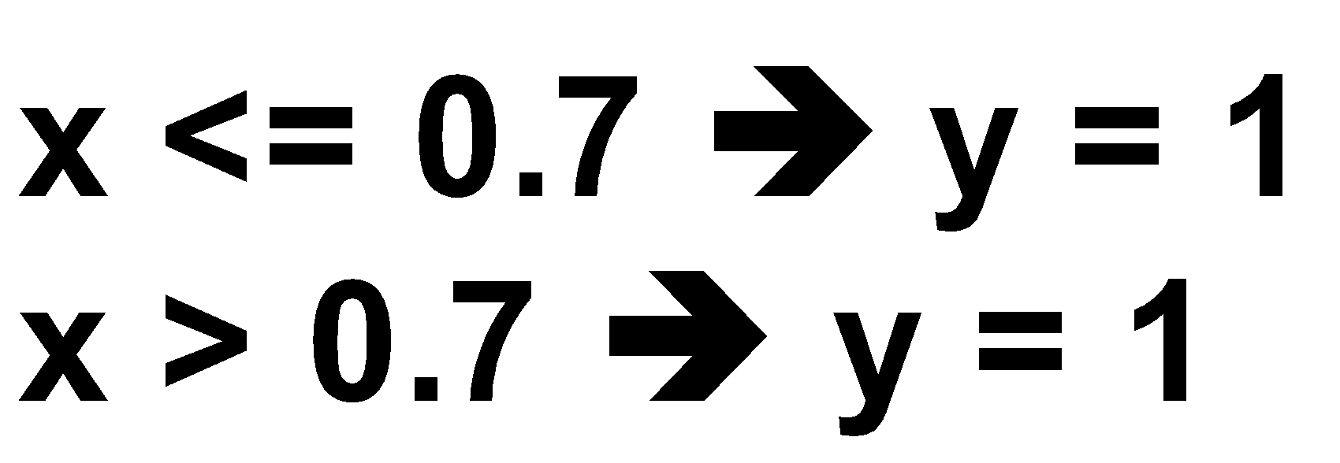
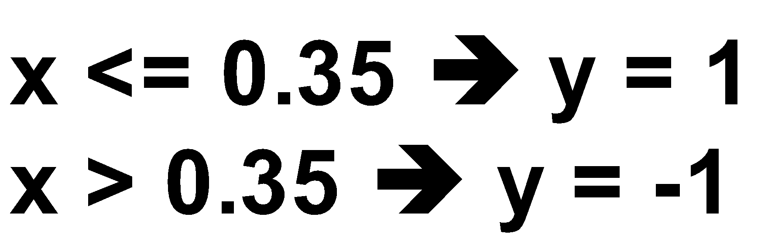
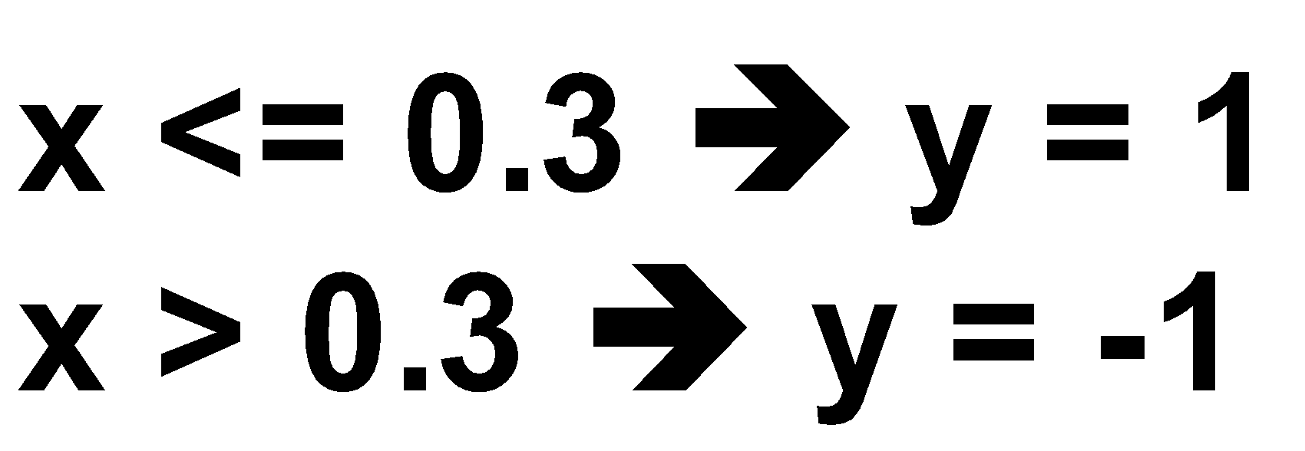
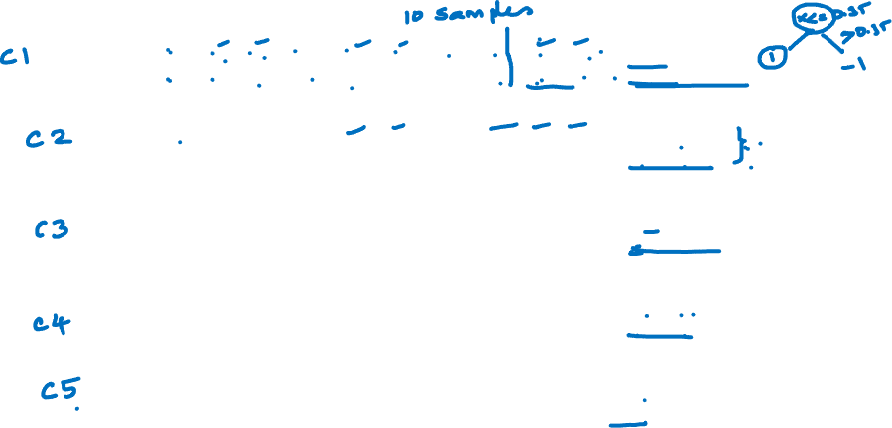
Bagging Example

Slide 58

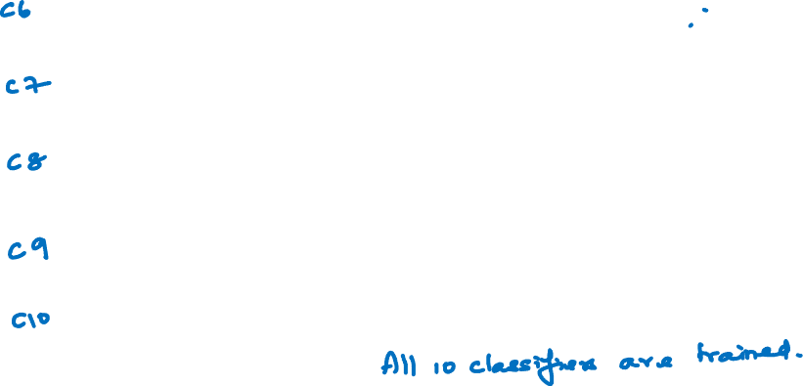
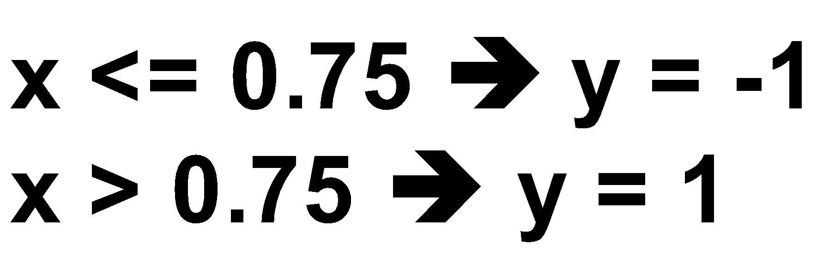
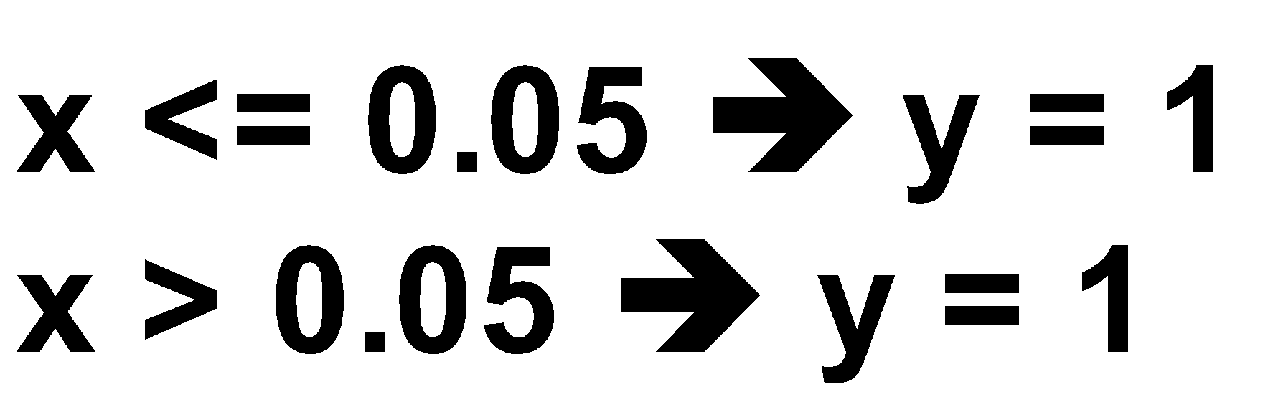
Bagging Example

Slide 59
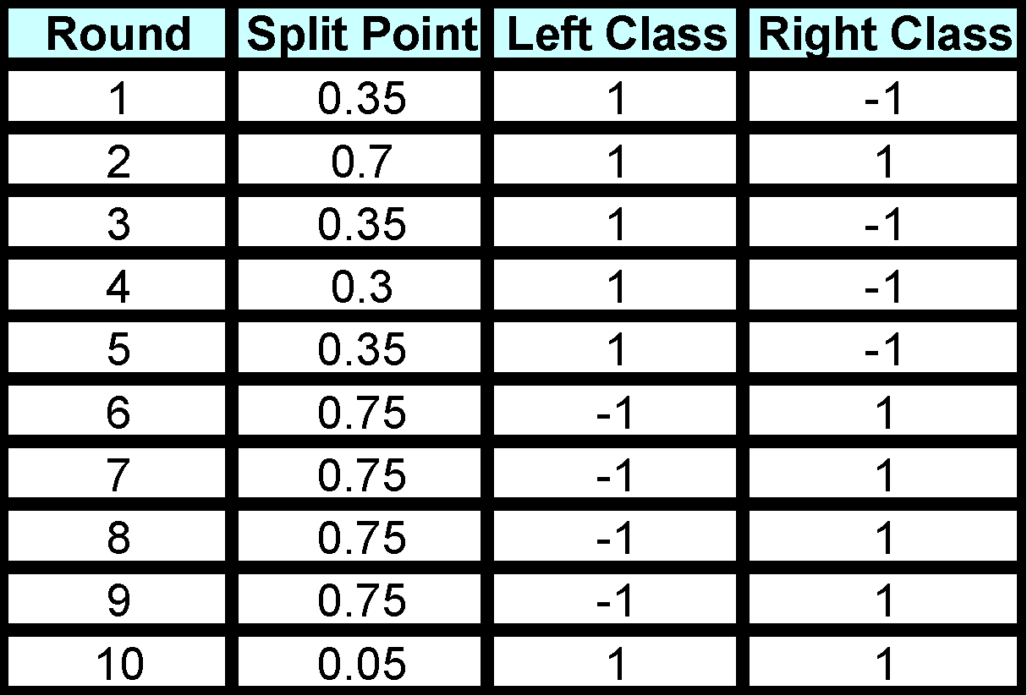

Bagging Example
Summary of Training set

Slide 60
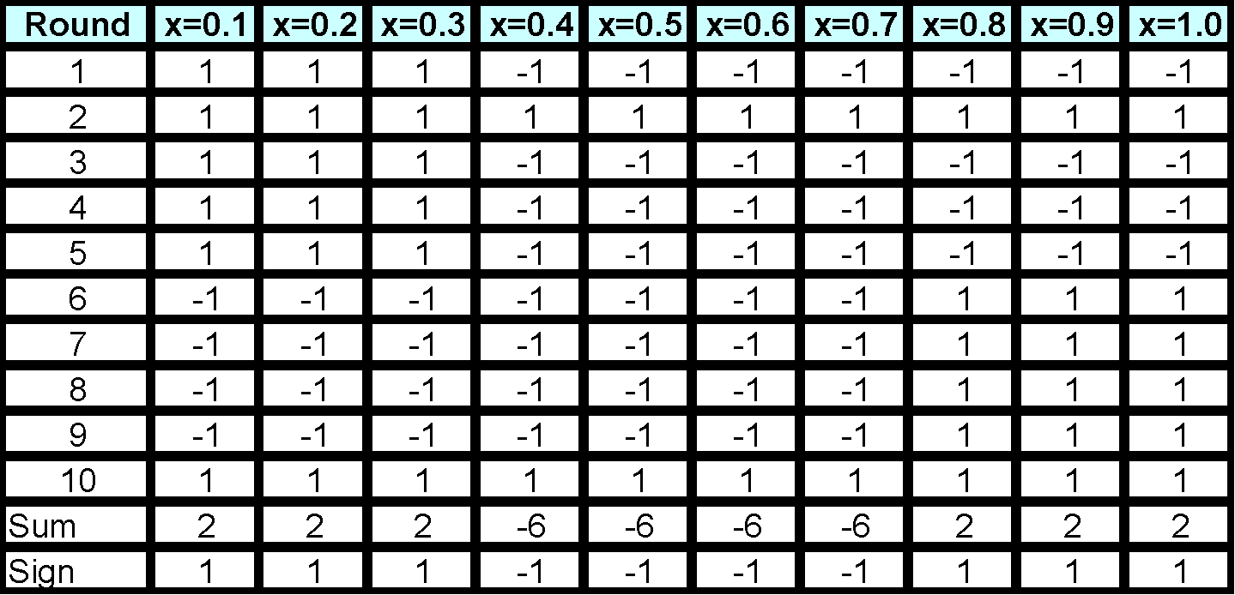
Bagging Example
Assume test set is the same as the original data
Use majority vote to determine class of ensemble classifier
Predicted Class
Accuracy of ensemble classifier: 100%

Slide 61
Bagging Algorithm

Slide 62
Boosting
An iterative procedure to adaptively change distribution of training data by focusing more on previously misclassified records
Initially, all N records are assigned equal weights (for being selected for training)
Unlike bagging, weights may change at the end of each boosting round
Sample with nonuniform distribution
. Unlike bagging where each instance had equal chance of being selected
. Motivation: focus on instances that are harder to classify
. How: give harder instances more weight in future rounds

Slide 63
Boosting
An iterative procedure to adaptively change distribution of training data by focusing more on previously misclassified records
Initially, all N records are assigned equal weights (for being selected for training)
Unlike bagging, weights may change at the end of each boosting round
Records that are wrongly classified will have their weights increased in the next round
Records that are classified correctly will have their weights decreased in the next round
Example 4 is hard to classify
Its weight is increased, therefore it is more likely to be chosen again in subsequent rounds

Slide 64
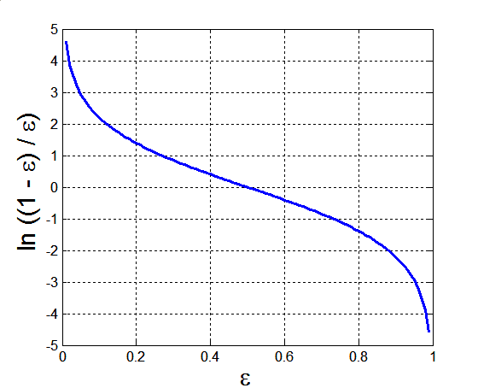
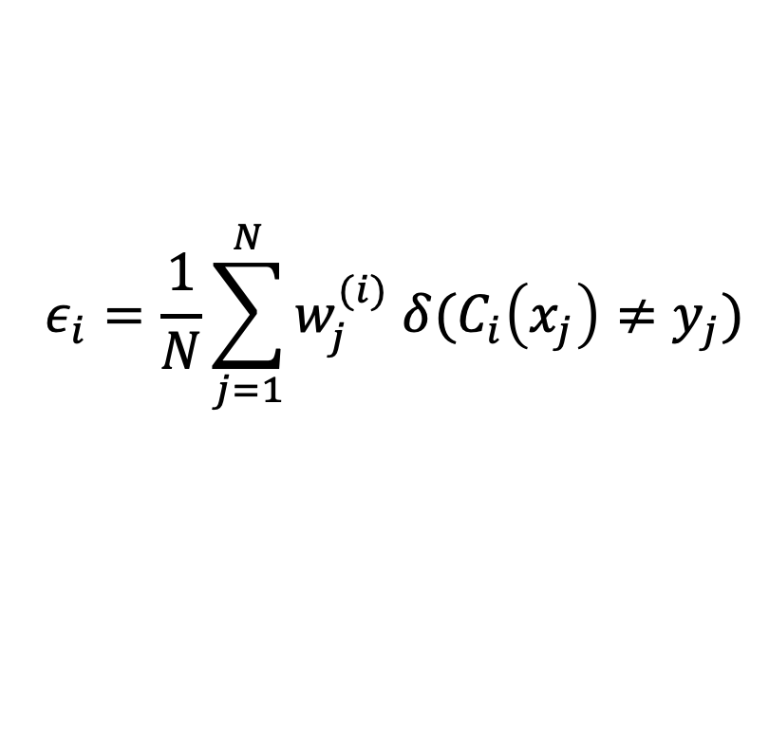
AdaBoost
Base classifiers: C₁, C₂, …, C_{T}
Error rate of a base classifier:
Importance of a classifier

Slide 65


AdaBoost Algorithm
Weight update for j-th training data at i-th step
If any intermediate rounds produce error rate higher than 50%, the weights are reverted back to 1/n and the resampling procedure is repeated
Classification
Equation 1

Slide 66
AdaBoost Algorithm
1

Slide 67
AdaBoost Example
Consider this one dimensional dataset
Classifier is a decision stump
Decision rule: x ≤ k versus x > k
Split point k is chosen based on entropy
x ≤ k
True
False
y_{left}
y_{right}

Slide 68


AdaBoost Example

Slide 69


AdaBoost Example - Explanation

Slide 70

AdaBoost Example- Explanation

Slide 71

AdaBoost Example- Explanation

Slide 72

AdaBoost Example- Explanation

Slide 73
AdaBoost Algorithm

Slide 74
Random Forest
Ensemble method specifically designed for decision tree classifiers
Random Forests grows many trees
Ensemble of unpruned decision trees
Each base classifier classifies a “new” vector of attributes from the original data
Final result on classifying a new instance: voting. Forest chooses the classification result having the most votes (over all the trees in the forest)

Slide 75
Random Forest
Introduce two sources of randomness: “Bagging” and “Random input vectors”
Bagging method: each tree is grown using a bootstrap sample of training data
Random vector method: At each node, best split is chosen from a random sample of m attributes instead of all attributes

Slide 76

Random Forest

Slide 77

Random Forest Algorithm
For b = 1 to B
Draw a bootstrap sample Z∗ of size N from the training data.
Grow a random-forest tree to the bootstrapped data, by recursively repeating the following steps for each terminal node of the tree, until the minimum node size n_{min} is reached.
Select m variables at random from the p variables.
Pick the best variable/split-point among the m.
Split the node into two daughter nodes. Output the ensemble of trees.
To make a prediction at a new point x we do
For regression: average the results
For classification: majority vote

Slide 78
Characteristics
Advantages
Algorithm can solve both classification and regression problems
Can handle large data set with higher dimensionality.
It can handle thousands of input variables and identify most significant variables
dimensionality reduction
Model outputs Importance of variable, which can be a very handy feature (on some random data set).
Disadvantages
May over-fit datasets that are particularly noisy.
When the number of variables is large, but the fraction of relevant variables is small, random forests are likely to perform poorly when m is small
At each split the chance can be small that the relevant variables will be selected
For example, with 3 relevant and 100 not so relevant variables the probability of any of the relevant variables being selected at any split is ~0.25
Random Forest can feel like a black box approach for statistical modelers
you have very little control on what the model does.
You can at best try different parameters and random seeds!

Slide 79

Empirical comparison among Ensemble Methods

Slide 80
Thank You!

